Slide 1
Agentic AI POC
Intelligent Document Processing

Slide 2
Key concepts
LangChain - LangChain is an open-source framework that simplifies the process of building applications with large language models (LLMs). LangChain is built around a small set of components—LLMs, prompts, chains, tools, agents, and memory—that you wire together to rapidly prototype and productionize LLM apps.
LangGraph - Langraph is built on top of Langchain & its functions. While LangChain provides the building blocks, LangGraph takes it a step further by allowing us to define stateful, multi-actor LLM applications as graphs. It is the graph-based framework for LLM-powered agents.
Components of LangGraph –
  Graph - A directed graph that represents your end-to-end workflow.
  Nodes - the individual steps/tasks)
  Edges - Define the flow of data between nodes.
  State- Snapshot of all intermediate data, context variables, and progress markers for each node.
  START, END – inbuilt nodes
Agents - They are the AI decision makers that can pick the right tool for the job without being explicitly told what tool to use.
Tools - Tools are specific functions that agent can use to complete tasks

Slide 3
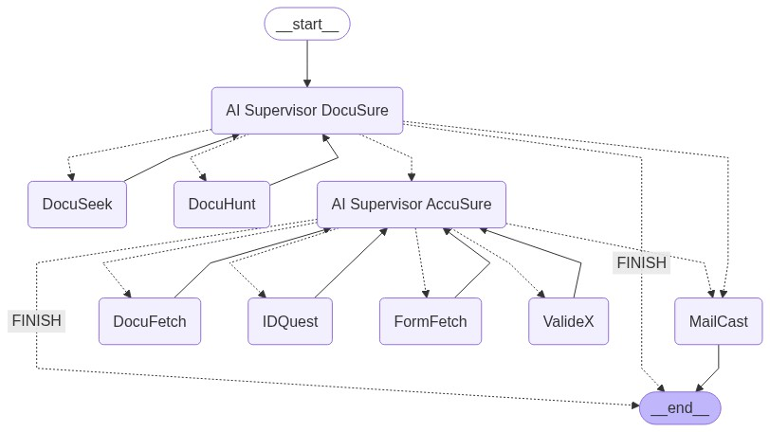
Agentic AI - Architecture

Slide 4
Agents
In the context of LLMs, an agent is an intelligent entity that uses a language model to reason about what actions to take, executes those actions using available tools, observes the outcomes, and then repeats the cycle until a task is completed. Instead of a fixed sequence of operations, agents can dynamically decide their next step. Our system employs specialized agents, such as:
MongoDB Agent (DocuSeek): Responsible for interacting with our document database to retrieve customer files.
Completeness Agent (DocuHunt): Checks if all necessary documents for KYC are present
Gmail Agent (MailCast): Handles sending automated emails, for example, to customers regarding incomplete documents.
OCR Agent (IDQuest): Perform the OCR on available documents to extract the customer’s information.
RAG Agent (FormFetch): Uses RAG method to extract the relevant customer’s information from the KYC form.
Compare Agent (Validex): Compares information extracted from the KYC application form (RAG output) with data extracted from various OCR agents to verify consistency and calculate similarity scores.

Slide 5
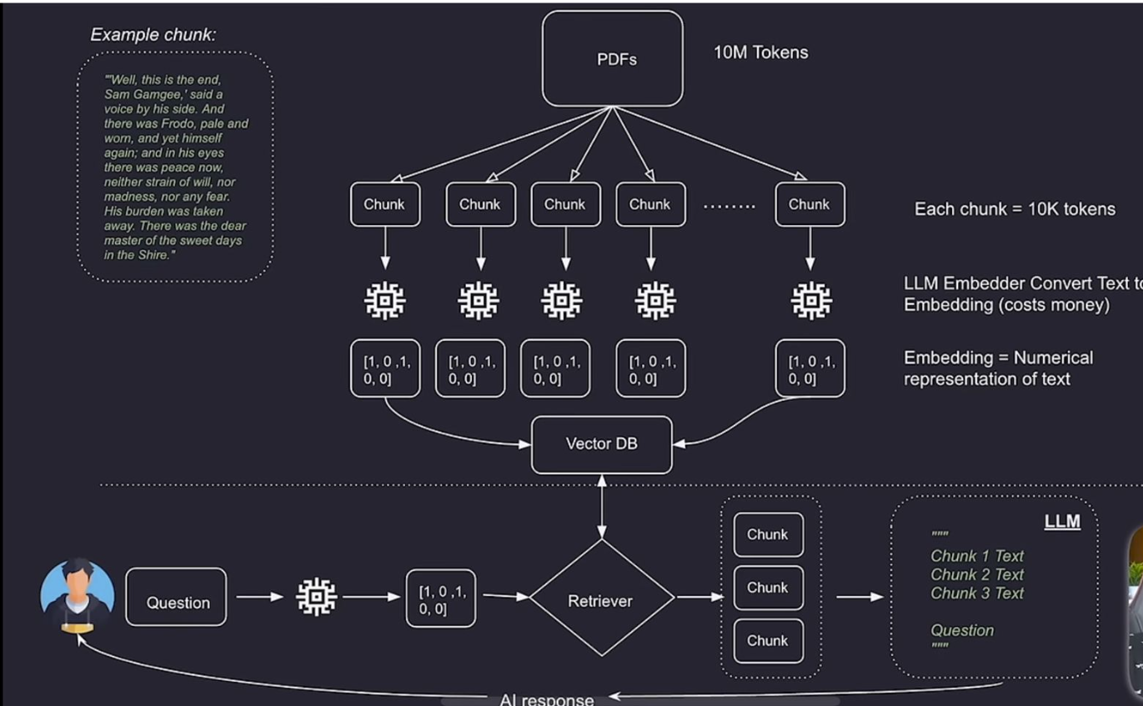
RAG – Retrieval-Augmented Generation
RAGs give LLMs additional knowledge

Slide 6
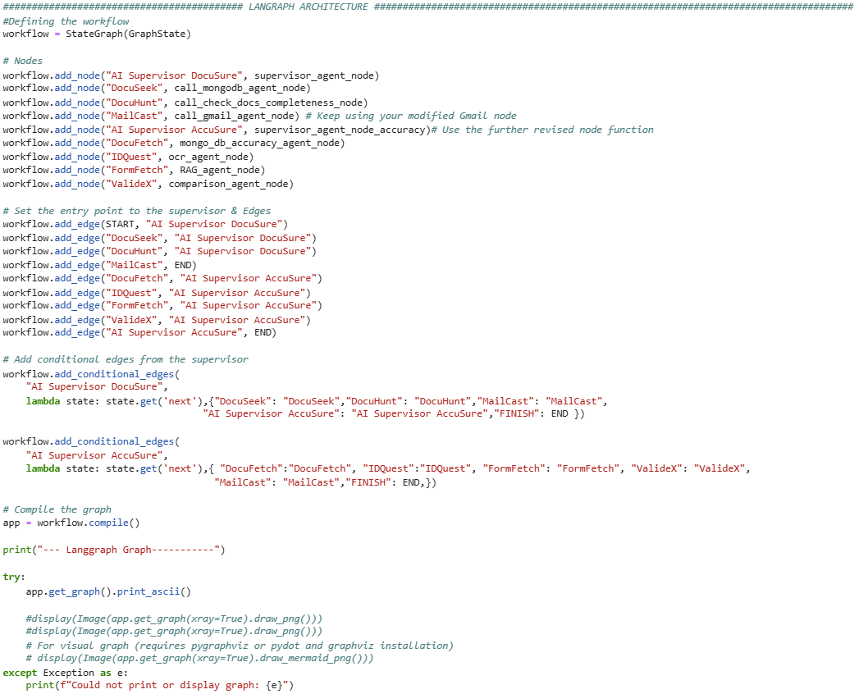
LangGraph Architecture (Code)

Slide 7
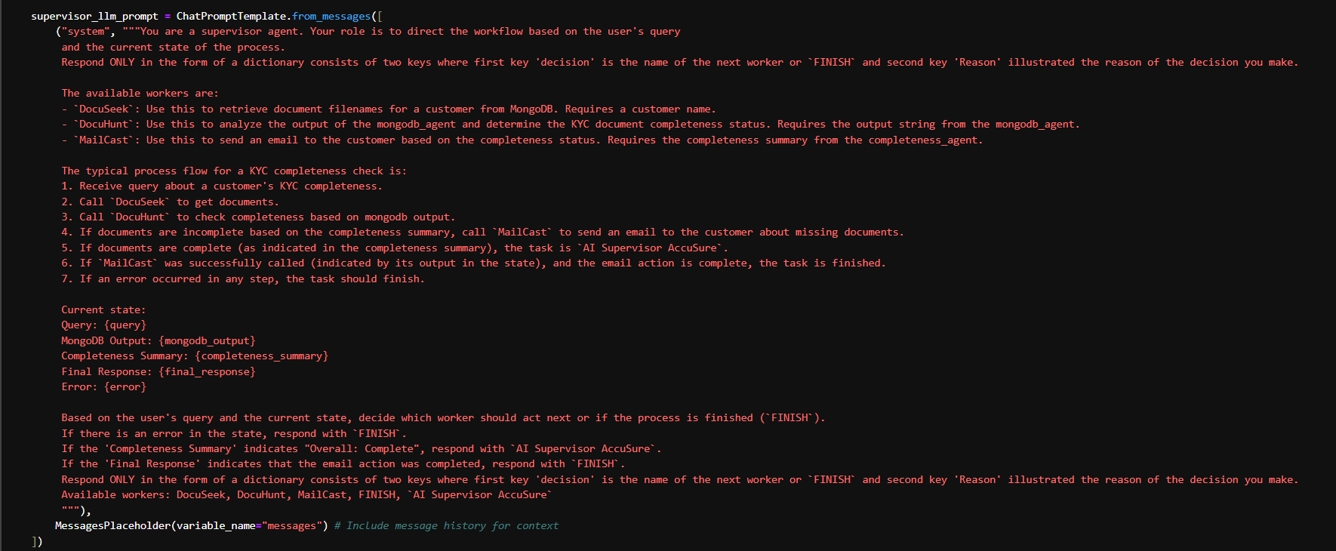
AI Supervisor DocuSure Prompt

Slide 8
Streamlit
Streamlit is an open-source Python library that makes it incredibly easy to create custom web applications for data science and machine learning. It allows us to build interactive dashboards and user interfaces directly from Python scripts. In our system, Streamlit provides the front-end where users can interact with the document processing workflow, providing inputs, viewing results, and observing the system's progress.
Basic Components of streamlit:-
st.write(): To display text, data frames, plots, and more.
st.text_input(): To get text input from the user (e.g., for queries or IDs).
st.button(): To trigger actions within the application.
st.file_uploader(): To allow users to upload documents.
st.progress() / st.spinner(): To indicate ongoing processes and provide feedback to the user.

Slide 9
DEMO

Slide 10
APPENDIX

